Slide 1
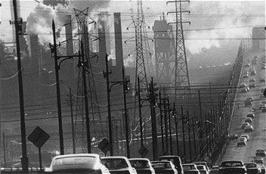
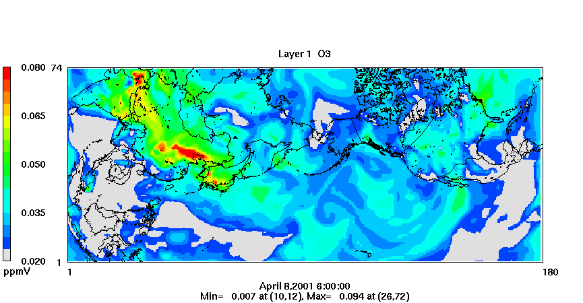
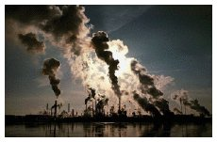
Community Multiscale Air Quality (CMAQ) Modeling System
version 5.0 Training
http://www.cmaq-model.org

Slide 2
Training Overview
AQM overview
CMAQ basics
CVS, I/O API, netCDF
CMAQ scripts
CMAQ programs and options
CMAQ concepts
Evaluation and QA
Overview lab
MCIP lab
ICON lab
BCON lab
CCTM lab
Nesting lab
Multi-day lab
LNOX lab
Case Study
Classroom 1
Laboratory
Classroom 2

Slide 3
Chemistry-Transport Modeling
Meteorology
Emissions
Initial/Boundary Conditions
Chemistry Transport Model
Inputs to CTMs include
  Meteorology – e.g. winds, temperature, precipitation
  Emissions – pollutant fluxes from industrial, mobile, natural, and other sources
  IC/BC – fluxes at the model boundaries
Outputs from CTMs include
  Hourly concentrations of gases and particles
  Hourly wet and dry deposition totals
CTMs are open-source, Linux software designed to run on large computing clusters
Notes:
IC/BC: intial and boundary conditions

Slide 4
CTM Process Schematic
Hourly
Concentrations
Emissions
Modeling
Model Ready
Emissions
Cumulative
Wet Dep
Met
Modeling
2-D/3-D Met
Files
CTM
Cumulative
Dry Dep
IC
Preparation
IC
Input File
Visibility
Metrics
BC
Preparation
BC
Input File
Diagnostic
Outputs
Photolysis
Rates
Clear Sky
J Rates

Slide 5
Conceptual approach to CTMs
Extend the 2-D box model to three dimensions
2-D
3-D
∆x
∆x
∆z
u₁C₁
u₂C₂
u₁C₁
u₂C₂
C_{i}
∆y
C_{i}
∆y
Basic Continuity Equation (flux in 1 direction):
∆C ∆x ∆y ∆z = u₁C₁∆y ∆z ∆t – u₂C₂ ∆y ∆z ∆t
Divide by ∆t and volume: ∂C/ ∂t = - ∂(uC)/ ∂x
u = wind vector
C_{i} = concentration of species i

Slide 6
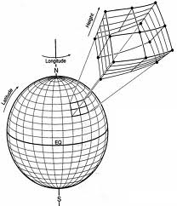
Expanded Continuity Equation
Expanded Continuity Equation Derivation:
Expand to flux three dimensions:
∂C/ ∂t = - ∂(uC)/ ∂x - ∂(vC)/ ∂y - ∂(wC)/ ∂z
= - ∙ (vC) (flux divergence form)
Add additional production and loss terms:
∂C/ ∂t + ∙ (vC) = D ² C + R + E - S
w₂C₂
3-D
∆x
∆z
u₁C₁
u₂C₂
R_{i}
X
v₁C₁
∆y
E
S
w₁C₁
u,v,w = wind vectors
E = emissions
S = loss processes
R_{i} = Chemical formation of species I
D = Molecular diffusion coefficient

Slide 7
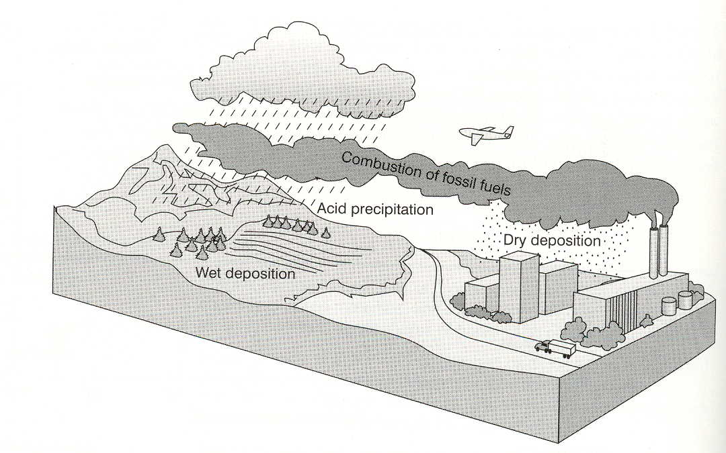
Gas Chemistry:
Aqueous Chemistry:
Aerosol Processes:
R_{chem}
R_{hr}
R_{nuc} + R_{c/e} + R_{dp/s} + R_{ds/e} + R_{hr}
Diffusion: D ² C
Advection: - ∙ (vC)
Boundary Conditions
R_{emis}
R_{dep}
R_{wash}
R = Rate
chem=chemical production/loss, hr=heterogeneous reactions, nuc=nucleation, c/ev=condensation/evaporation, dp/s=depositional growth/sublimation, ds/e=dissolution/evaporation, wash=washout, dep=deposition, emis=emissions

Slide 8
Full Continuity Equations
Gas Continuity Equation
∂C/ ∂t + ∙ (vC) = D ² C + R_{chemg} + R_{emisg} + R_{depg}+ R_{washg} + R_{nucg} + R_{c/eg} + R_{dp/sg} + R_{ds/eg} + R_{hrg}
Particle Continuity Equation (number)
∂n/ ∂t + ∙ (vn) = D ² n + R_{emisn} + R_{depn}+ R_{sedn} + R_{nucn}
+ R_{washn} + R_{coagn}
Particle Continuity Equation (volume concentration)
∂V/ ∂t + ∙ (vV) = D ² V + R_{emisv} + R_{depv}+ R_{sedv} + R_{nucv}
+ R_{washv} + R_{coagv}+ R_{c/ev} + R_{dp/sv} + R_{ds/ev}
+ R_{egv} + R_{qgv} + R_{hrv}

Slide 9
Atmospheric Diffusion Equation (ADE)
ADE* represents mass balance in which emissions, transport, diffusion, chemical reaction and removal processes are represented by:
* Several assumptions included above

Slide 10
ADE (..Contd.)
where,
i = chemical species, i (where i = 1, 2, … N )
C_{i} = pollutant concentration of species, i
u, v, w = horizontal and vertical wind speed components = f (x, y, z, t )
K_{H}, K_{V} = horizontal and vertical turbulent diffusion coefficients = f (x, y, z, t )
R_{i} = rate of formation of i by chemical reactions = f ( C₁, C₂, .., C_{i}, .. C_{N})
S = emission rate of all precursors
L_{i} = net rate of removal of pollutant i by surface uptake processes = f (x, y, z, t )

Slide 11
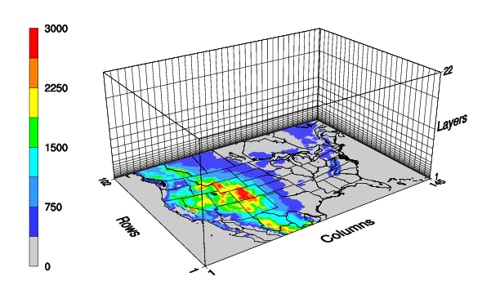
3-D Box Representation

Slide 12
Numerical Solution of Partial Differential Equations (PDEs)
E.g. Model Application with 100 Columns X 100 Rows X 25 Layers = 250,000 grid-cells
CB-IV Chemical Mechanism with 79 species and 94 reactions
Number of differential equations to be solved simultaneously per model output time step = 250,000 X 79 = 19,750,000
For 1 day, # ODEs = 19.75 X 24 = 474 million
For 1 month, # ODEs = 19.75 X 24 X 30 = 14.22 billion
For 1 year, # ODEs = 19.75 X 24 X 365 = 173 billion

Slide 13
CTM Coordinate Systems
Convert all motion equations from Cartesian to spherical coordinates
Horizontal grids typically on the order of 1 to 36 km
Recent applications extending to 500m and 108 km
Lambert conformal, polar stereographic, and Mercator are the most common modeling projections
dx = (R_{e}cosφ)dλ_{e} dy = R_{e}d φ

Slide 14
CTM Coordinate Systems
Vertical grids extend from the surface to 10 km
Altitude coordinate: layers are defined as surfaces of constant height with variable pressure
Pressure coordinate: layers are defined as surfaces of constant pressure with variable height
Sigma-pressure coordinate: layers defined as surfaces of constant σ, where
p_{a} – p_{a,top}
σ =
(0,1)
p_{a, surf} - p_{a,top}

Slide 15
CMAQ Basics
Definitions & Acronyms
CMAQ Basics
CMAQ Modules
CMAQ Scripts

Slide 16
Definitions & Acronyms
SMOKE: Sparse Matrix Operator Kernel Emission processing system
CCTM: CMAQ Chemical Transport Model
BCON: Boundary Conditions processor
ICON: Initial Conditions processor
JPROC: Photolysis rates processor
MCIP: Meteorology Chemistry Interface Processor
CB05cl: Carbon Bond version 2005 chemical mechanism with chlorine chemistry

Slide 17
CMAQ Basics
CMAQ designed under the community modeling paradigm:
  Modular
  Multiscale
  One-atmosphere
  Portable
  Accessible
Can model from urban (few km) to regional (hundreds of kilometers) to inter-continental (thousands of kilometers) scales of transport
Tropospheric O₃, acid deposition, visibility, particulate matter, toxics, mercury
Requires inputs from emissions and meteorology models, initial and boundary conditions
CMAQ = Chemical Transport Model + preprocessors

Slide 18
CMAQ Modules
ICON
BCON
JPROC
LNOx
MCIP
CCTM

Slide 19
CMAQ Modules – ICON (1)
ICON is the CMAQ initial conditions preprocessor
Generates IC’s from:
  Text-based vertical profiles
  netCDF CTM output
Grid windowing
Default and custom mechanism conversion
Creates netCDF IC output file
Example text-based input file:

Slide 20
CMAQ Modules – ICON (2)
Optional initial condition:
The vertical coordinate of the model to generate these i.c. is the terrain-following sigma coordinate. The number of sigma layers and defined sigma levels are listed below.
6 55 1.00 0.98 0.93 0.84 0.60 0.30 0.00
1988180 00
"SO2 " 0.300E-03 0.200E-03 0.100E-03 0.100E-03 0.200E-04 0.100E-04
"SULF " 1.000E-30 1.000E-30 1.000E-30 1.000E-30 1.000E-30 1.000E-30
"NO2 " 0.167E-03 0.167E-03 0.084E-03 0.000E+00 0.000E+00 0.000E+00
"NO " 0.083E-03 0.083E-03 0.042E-03 0.000E+00 0.000E+00 0.000E+00
"O3 " 0.350E-01 0.350E-01 0.400E-01 0.500E-01 0.600E-01 0.700E-01

Slide 21
CMAQ Modules – BCON (1)
BCON is the CMAQ boundary conditions preprocessor
Generates BC’s from:
  Text-based vertical profiles
  netCDF CTM output
Static and time-dependent BC’s
Grid windowing capabilities
Default and custom mechanism conversion
Creates netCDF BC output file
Example text-based input file:

Slide 22
CMAQ Modules – BCON (2)
Optional boundary condition:
The vertical coordinate of the model to generate these b.c. is the terrain-following sigma coordinate. The number of sigma layers and defined sigma levels are listed below.
6 55 1.00 0.98 0.93 0.84 0.60 0.30 0.00
1988180 00
North
"SO2 " 0.300E-03 0.200E-03 0.100E-03 0.100E-03 0.200E-04 0.100E-04
"SULF " 1.000E-30 1.000E-30 1.000E-30 1.000E-30 1.000E-30 1.000E-30
"NO2 " 0.167E-03 0.167E-03 0.084E-03 0.000E+00 0.000E+00 0.000E+00
"NO " 0.083E-03 0.083E-03 0.042E-03 0.000E+00 0.000E+00 0.000E+00
"O3 " 0.350E-01 0.350E-01 0.400E-01 0.500E-01 0.600E-01 0.700E-01

Slide 23
CMAQ Modules – JPROC (1)
JPROC is the CMAQ photolysis rate preprocessor
Generates daily photolysis lookup tables from:
  Tabulated molecular cross-section/quantum yield data as a function of wavelength
Creates ASCII PHOT output files
Example input file format:
ACROLEIN
FAC = 1.0
250.0 1.803E-21 1.000
251.0 1.805E-21 1.000
252.0 2.052E-21 1.000 …

Slide 24
CMAQ Modules – JPROC (2)
1999193 (yyyyddd) Julian Date for the file
7 LEVELS (m)
0.0 1000.0 2000.0 3000.0 4000.0 5000.0 10000.0
6 LATITUDES (deg)
10.0 20.0 30.0 40.0 50.0 60.0
9 HOUR ANGLES (from noon)
0.0 1.0 2.0 3.0 4.0 5.0 6.0 7.0 8.0
6 PHOTOLYTIC REACTIONS
'NO2_CBIV88 ', 1.0
1 1 1
5.1139301E-01 5.0172305E-01 4.6737903E-01 4.0507138E-01
3.0828261E-01 1.7023879E-01 3.4761846E-02 0.0000000E+00
0.0000000E+00

Slide 25
CMAQ Modules – LNOx (1)
LNOx is the lightning NOx emissions preprocessor
Three options for simulating the air quality impacts of lightning NO emissions in CMAQ:
  Input file of LNOx emissions that were calculated off-line
  Compute LNOx emissions in-line during a simulation directly from lightning flash counts estimated from the convective precipitation field in the input meteorology
  Compute LNOx emissions in-line using a combination of observed flash counts and simulated convective precipitation
A preprocessor is used to prepare a lightning NOx parameters input file for simulations that use option 3.

Slide 26
CMAQ Modules – MCIP
MCIP is the CMAQ meteorology preprocessor
Generates gridded 3-d and 2-d netCDF met inputs
Source data are MM5 binary MMOUT files or WRF netCDF files
MCIP3 optionally reads MM5 TERRAIN files for calculation of land-use based K_{v} in CMAQ
MCIP outputs can also be used with SMOKE for emissions modeling

Slide 27
CMAQ Modules - CCTM
The CCTM is an Eulerian air quality model
Configuration options for CCTM science modules determined at compilation
Dynamic horizontal grid allocation and vertical layer structure determined at execution
Basic outputs include hourly concentrations for gaseous and aerosol pollutants, wet and dry deposition fluxes, and visibility metrics
Supplementary outputs include inline emissions diagnostic files, land-use deposition files (MOSAIC), and process analysis outputs

Slide 28
CCTM Science Process Modules
DRIVER → controls model data flows
HADV → horizontal advection
VADV → vertical advection
ADJCON → adjusts mixing ratios of pollutants
HDIFF → horizontal diffusion
VDIFF → vertical diffusion and deposition
CHEM → gas-phase chemistry
CLOUD → aqueous-phase chemistry, cloud-mixing
AERO → aerosol dynamics and size distributions
PHOT → computes photolysis rates
AERO-DEPV → computes particle size-dependent dry deposition velocities
UTIL → collection of utility subroutines

Slide 29
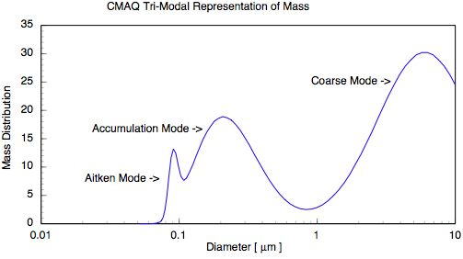
PM Treatment in CMAQ
Particle size distribution is represented as the superposition of 3 lognormal sub-distributions (modes)
  Aitken mode (up to ~ 0.1 microns) (typically for fresh particles)
  Accumulation mode (0.1 - 2.5 microns) (aged particles)
  Coarse mode (2.5 – 10 microns)
  PM₁₀ is the sum of all three modes
For each mode, model predicts
  Various chemical components of PM_{2.5}
    Primary: Organics, Elemental Carbon, Crustal
    Secondary: Sulfate, Nitrate, Ammonium, Organic Aerosol (Anthropogenic, Biogenic)
Additional outputs
  particle number, total surface area and total mass
Ref: Binkowski et al, JGR, 2003

Slide 30
CMAQ Scripts
Build scripts and Makefiles
Run scripts

Slide 31
CMAQ Build Scripts (1)
The CMAQ system is entirely composed of Fortran programs
Bldmake is used for configuration management and compilation in the CMAQ system
Bldmake functions:
  checks out working copies of the CMAQ source code from a repository
  generates an Makefile
  executes the Makefile to create an executable
Each CMAQ module has a build script associated with it that calls Bldmake (MCIP uses a Makefile)

Slide 32
CMAQ Build Scripts (2)
Operating system dependencies are handled by the Bldmake scripts (i.e, location and type of Fortran compiler, compilation flags, location of source code on system)
The build scripts contain configuration information that is used to check copies of the CMAQ source code out of a Concurrent Version System (CVS) code repository
The CMAQ build scripts provide the option of either generating executables directly or creating Makefiles

Slide 33
Makefiles
Alternative to build scripts for compiling executables
Require that the source code is online, i.e. no CVS options built into the script
Operating system dependencies
MCIP is the only CMAQ module that is currently distributed with only a Makefile option for compilation

Slide 34
Run Scripts
User interface for CMAQ
CMAQ run scripts are C-shell files that set necessary environment variables, directory and file locations, and call executables
Settings defined in the CMAQ run scripts include:
  Input and output file nomenclature
  Horizontal grid definitions
  3-d meteorology file for setting vertical layer structure
  Start date, start time, time step, and run duration
  Logfile options
  Debug options
The CCTM run script also includes several scientific configuration options

Slide 35
CMAQ Libraries and Utilities
I/O API
netCDF
mpich
Stenex
Pario
CVS
VERDI

Slide 36
CMAQ Libraries and Utilities
Library files provide an easy way for programs to share commonly used subroutines; three libraries used by CMAQ
I/O API - an easy-to-learn, easy-to-use programming library for data storage and access, available for both Fortran and C
netCDF - an interface for array-oriented data access and a library that provides an implementation of the interface
mpich – message passing interface for parallel computing

Slide 37
CMAQ Libraries and Utilities
Stenex - the Stencil Exchange library is required for parallel processing
Pario – a set of library routines that control CMAQ input/output for multiprocessor applications

Slide 38
I/O API Utilities
The Input/Output Applications Programming Interface contains an extensive set of utility routines for manipulating dates and times, performing coordinate conversions, storing and recalling grid definitions, sparse matrix arithmetic, etc., as well as a set of data-manipulation and statistical analysis programs
Command line programs that are easy to script for automating analysis and post processing
http://www.baronams.com/products/ioapi/
Examples of I/O API utilities

Slide 39
I/O API Utilities
m3diff: for computing statistics for pairs of variables and for applying various comparison ("differencing") operations to those variables in a pair of files
m3edhdr: edit header attributes/file descriptive parameters
m3merge: merges selected variables from a set of input files for a specified time period, and writes them to a single output file, with optional variable-renaming in the process
vertot: compute vertical-column totals of variables in a file

Slide 40
netCDF Library
The Network Common Data Form is an interface to a library of data access functions for storing and retrieving data in the form of arrays
An abstraction that supports a view of data as a collection of self-describing, network-transparent objects that can be accessed through a simple interface
By using direct file access, netCDF achieves the goal of supporting efficient access to small subsets of large datasets
www.unidata.ucar.edu/packages/netcdf/

Slide 41
CVS
Concurrent Versions System is a source code version control system that operates on a hierarchical directory structure to manage code releases and control the concurrent editing of files among multiple authors
Version control systems are primarily used in development environments where multiple programmers may be accessing source code simultaneously
In CMAQ, CVS is used simply as a code repository for protecting the distributed files from direct access

Slide 42
CVS
Instead of directly accessing the source code in the CMAQ distribution, you use CVS to access copies of the code
If you manipulate these copies when they are checked out of CVS, you can check them back into the repository, where CVS will record information of the nature and timing of the file revisions
http://www.cvshome.org
Examples of CVS commands

Slide 43
CVS
cvs checkout foo – checks out your own working copy of the source for ‘foo’ into the current directory
cvs commit foo – checks your working copy of the source for ‘foo’ into the CVS archive
cvs –n update foo – lists the files that have changed in the source for ‘foo’ since checking them out of the CVS archive
cvs add bar – adds a node to the CVS archive for the source for ‘bar’

Slide 44
VERDI
Visualization Environment for Rich Data Interpretation is Java graphics tool for I/O API-netCDF formatted data
VERDI was developed as a replacement for PAVE
Easily scriptable to automate plot generation
Creates 2-d tile plots, time series, 3-d mesh plots, bar charts, scatter plots, and integrates observations into graphics
http://www.verdi-tool.org

Slide 45
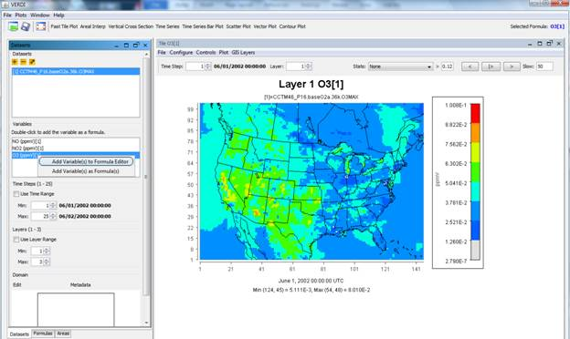
VERDI
Exports images and data in GIF, MPEG, Animated GIF, ascii text, and postscript
VERDI currently can be used to create 2-d tile plots, vertical cross sections, scatter plots, line and bar timeseries, contour plots, vector plots, and vector-tile plots
Intuitive GUI

Slide 46
IDV
Integrated Data Viewer is a Java graphics tool that supports multiple data formats
IDV is a 3-d visualization tool
Scriptable to automate plot generation
In addition to standard output formats (gif, mpeg, etc), also can output kmz files.
http://www.unidata.ucar.edu/software/idv/

Slide 47
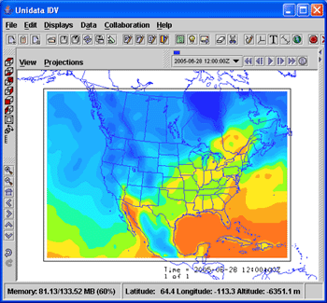
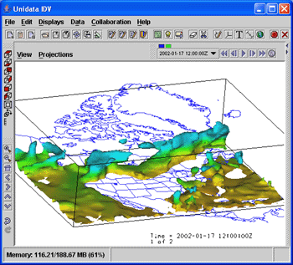
IDV

Slide 48
CMAQ Programs and Options
Compiler and execution options for:
  ICON
  BCON
  JPROC
  MCIP
  LNOx
  CCTM

Slide 49
ICON
Compilation Options
  Executable nomenclature
  m3bld options – e.g. compile_all, verbose, Makefile
  Input data type
  Debug mode?
  Chemical mechanism
Execution Options
  Episode nomenclature
  Horizontal grid resolution and grid definition
  Vertical layer structure
  Input/output directories and file names
  For nested runs: start date and time of parent data
  Executable name and location

Slide 50
BCON
Compilation Options
  Executable nomenclature
  m3bld options – e.g. compile_all, verbose, Makefile
  Input data type
  Debug mode?
  Chemical mechanism
Execution Options
  Episode nomenclature
  Horizontal grid resolution and grid definition
  Vertical layer structure
  Input/output directories and file names
  For nested runs: start date and time of parent data, run length
  Executable name and location

Slide 51
JPROC
Compilation Options
  Executable nomenclature
  m3bld options – e.g. compile_all, verbose, Makefile
  Chemical mechanism
  Debug mode?
Execution Options
  Episode nomenclature
  Time parameters: start date and end date
  Input/output directories and file names
  Executable location

Slide 52
MCIP – Compiler Options
Makefile configuration, no build script
Executable nomenclature
Platform-specific compiler options

Slide 53
MCIP – Execution Options
Episode nomenclature
Coordinate and grid names
Input/output directories and file names
Control options
  Compute and output potential vorticity
  Output vertical velocity
  Output u- and v- component winds on a C-grid
  Replace model-derived input with GOES observed clouds
Episode start and end dates/times
Sigma values of vertical layer boundaries
Meteorology boundary adjustment
Horizontal domain windowing options
Executable name and location

Slide 54
MCIP – Window vs Boundary Trim
WRF Domain
CMAQ Domain Boundary Adjustment
CMAQ Domain Window

Slide 55
CCTM – Compiler Options
Executable nomenclature
m3bld options – e.g. compile_all, verbose, Makefile
Science modules
  Horizontal and vertical advection module
  Horizontal and vertical diffusion module
  Deposition velocity module
  Chemistry input parameters module
  Gas-phase chemistry solver
  Aerosol chemistry module
  Cloud module
  Chemical mechanism
  Process analysis configuration
Debug mode?

Slide 56
CCTM – Execution Options₍₁₎
Episode nomenclature
Episode start date, start time, duration and time step
Logfile and diagnostic options
Input/output directories and file names
Horizontal grid name and grid definition
Synchronization time step
Specifications for integral averaged species output
Diagnostic output file options
Process analysis domain specifications
Executable name and location

Slide 57
CCTM – Execution Options₍₂₎
Inline and science options
  Calculate inline windblown dust emissions
  Include the impacts of erodible agricultural land on windblown dust emissions
  Calculate lightning NOx emissions
  Use a land-use based vertical diffusivity
  Calculate deposition velocities inline
  Calculate land-use specific deposition velocities with MOSAIC
  Use the ammonia bi-directional flux module
  Use the mercury bi-directional flux module
  Simulate atmosphere-surface HONO interactions
  Compute biogenic emissions inline with the BEIS3 model
  Compute plume rise for point sources inline

Slide 58
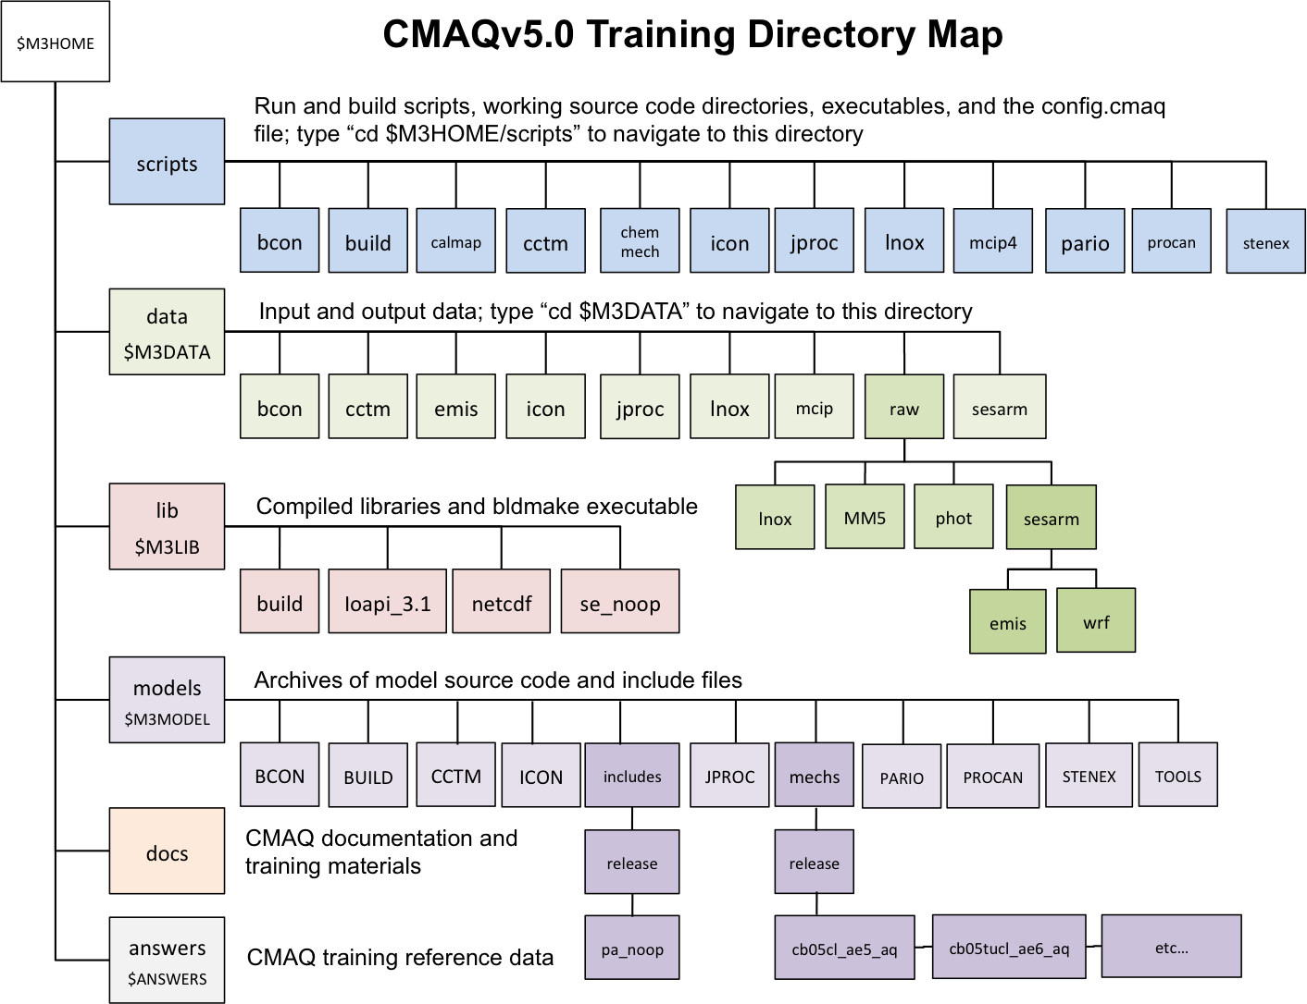

Slide 59
Training details
Training case was created from National Park Service modeling study (RoMANS)
  July 7, 2006 on two domains centered on Denver, CO
  50x50x16 cell, 12 km resolution
  50x50x16, 4 km resolution
CB05 chemical mechanism (EBI solver), aqueous chemistry, and aerosols (ISORROPIA for thermodynamics) – Mechanism cb05cl_ae5_aq
MCIP4.0
ACM clouds
No process analysis

Slide 60
About This Training
Specific to Linux and portable to most Linux platforms
Run CMAQ from scripts
Emphasis on operational, not technical aspects of CMAQ
Basic CMAQ functions covered

Slide 61
Air Quality Modeling Concepts
Model initialization/spin-up
Multi-day simulations
Nested simulations

Slide 62
Initialization/Spin-up
Initialization is performed to minimize the effects of initial conditions on the simulation results
Spin-up: A period at the beginning of a simulation with the purpose of initializing the model. Spin-up period results are typically discarded
No rule of thumb for the CMAQ spin-up duration
  Dependent on the grid resolution, magnitude of forcing from emissions and boundary conditions, and strength of horizontal and vertical transport
  Convention is to use a 2-week spin-up for regional modeling simulations

Slide 63
Multi-day Simulations
CMAQ simulations are typically continuous
No re-initialization from clean conditions after the spin-up period
To keep output file sizes manageable, multi-day simulations are stopped and restarted for each simulation day
  Subsequent days use the simulated concentrations from the previous day as initial conditions
 | Day 1 | Day 2 | Day 3 | Day 4 | Day 5
IC | clean | CONC₁ | CONC₂ | CONC₃ | CONC₄
Output | CONC₁ | CONC₂ | CONC₃ | CONC₄ | CONC₅

Slide 64
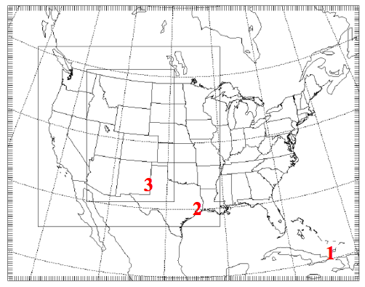
Nested Simulations
Nested modeling refers to embedding consecutively higher resolution modeling grids within each other
Nesting is used to simulate the lateral boundary conditions for a modeling domain
In the image to the right, grid 2 is “nested” in grid 1 and grid 3 is “nested” in grid 2
The BCs for grid 1 are “clean” and uniform in time and space
BCs for grids 2 and 3 are dynamic and extracted from previous grid

Slide 65
CMAQ Analysis Concepts
Process Analysis
Model Performance Evaluation and QA Procedures

Slide 66
Process Analysis (PA)(1)
Eulerian grid models are based on partial differential equations that define the time-rate of change in species concentrations due to chemical and physical processes
PA is a configuration system within Eulerian models that provides quantitative information about the impacts of individual processes on the cumulative chemical concentrations
PA is an optional feature of CMAQ that provides insight into the reasons for a model’s predictions

Slide 67
Process Analysis (PA)(2)
Two classes of PA
  Integrated reaction rates (IRR)
  Integrated process rates (IPR)
PA is useful for
  Identifying sources of error
  Interpreting model results
  Determining the important characteristics of chemical mechanisms (IRR)
  Determining the important characteristics of different implementations of physical processes (IPR)
  IPR quantifies the contribution of each source and sink process for a particular species at the end of each time step

Slide 68
Process Analysis (PA)(3)
CMAQ implementation requires compiling the CCTM with PA include files generated by the PROCAN preprocessor
PA include files specify
  IRR or IPR
  Chemical species or groups to collect PA information about
A PROCAN configuration file defines the contents of the include files
A PROCAN run script uses information in the configuration file and calls the executable to create the include files

Slide 69
Process Analysis (PA)(4)
PA_CMN
CCTM
PA
pa.inp
PA_CTL
PROCAN
PA_DAT
Configuration File
Include Files

Slide 70
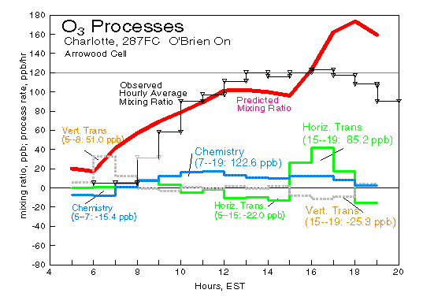

Slide 71
Process Analysis (PA)(7)
IRR quantifies the mass throughput of a particular reaction within a chemical mechanism
IRR can diagnose mechanistic and kinetic problems within the chemistry model
IRR can reveal NO_{x} vs. VOC sensitivity regimes
IRR generally more difficult to interpret than IPR

Slide 72
Model Performance Evaluation (MPE)
Question why a model is doing what it is doing
What are the inherent uncertainties and how do they impact the model results
Qualitative and quantitative evaluation
Diagnostic versus operational evaluation
Comparisons against observations
Evaluate at different temporal and spatial scales
Categorical model evaluation (used for Forecasting)
  Contingency Table, False Alarm Rate, Skill Scores, CSI, etc.

Slide 73
Quantitative vs Qualitative
Qualitative model evaluation targets intuitive features in results
  Effects of urban areas
  Boundary layer effects
  Effects of large point sources and highways
  Diurnal phenomena
Quantitative evaluation provides statistical evidence for model performance
  Daily, seasonal, annual comparisons with observed data
  At coarse grids, compare observations with the concentrations in the model grid cell in which the monitor is located
  At fine grids, compare observations with the concentrations in a matrix of cells surrounding the cell in which the monitor is located

Slide 74
Problems/Issues
Modeling scales have grown tremendously both spatially and temporally
  Datasets becoming larger
  Need to process and digest voluminous amount of information
Heterogeneous nature of observational datasets
  Vary by network, by quality, by format, by frequency
Measurement or model artifacts
  What is modeled is not always measured
  Need adjustments before comparisons
Problem of incommensurability
  Comparing point measurement with volume average

Slide 75
Observational Databases
AIRS (hourly) (~4000)
IMPROVE (every 3rd day) (~160)
CASTNET (hourly, weekly) (123)
NADP (weekly) (over 200)
EPA Supersites (sub-hourly) (8)
EPA STN (hourly) (215)
PAMS (hourly) (~130)
AERONET
Special field campaigns
  e.g. AIRMAP, ASACA, BRAVO, CCOS, CRPAQS, NARSTO, SEARCH, SOS, TXAQS, etc.
  Aircraft Data
Remote Sensing Data (AURA, MODIS, etc.)

Slide 76
Operational Evaluation
(mostly quantitative)
Compute suite of statistical measures of performance
  Peak Prediction Accuracy, Bias metrics (MB, MNB, NMB, FB), Error metrics (RMSE, FE, GE, MGE, NMGE), etc.
  “Goodness-of-fit” measures (based on correlation coefficients and their variations)
  Various temporal scales
Time-series analyses
  Hourly, weekly, monthly
Grid (tile) plots
Scatter plots
Pie-charts

Slide 77
Diagnostic Evaluation
(qualitative and quantitative)
Compute various ratios
  Metrics different for each problem being diagnosed / studied
    O₃/NO_{z,},H₂O₂/HNO₃ for NO_{x} versus VOC limitation
    NO_{z}/NO_{y} for chemical aging
    PM species ratios such as NH₃/NH_{x}, NO₃/(total nitrate) for gas-particle partitioning, NH₄/SO₄, NH₄/NO₃, etc.
    Others?
Innovative Techniques
  Empirical Orthogonal Functions
  Principal Component Analyses
  Process Analyses
  Source Apportionment (available for Carbon and Sulfur)
  Decoupled-direct method (DDM)
  Others?

Slide 78
Analyses Tools for MPE
sitecmp to prepare obs-model pairs
  Part of CMAQ Distribution
VERDI
  http://www.verdi-tool.org
I/O API Utilities
  http://www.baronams.com/products/ioapi
netCDF Operators
  http://nco.sourceforge.net
NCAR Command-line Language
  http://www.ncl.ucar.edu
Python I/O API Tools
  http://www-pcmdi.llnl.gov/software-portal/Members/azubrow/ioapiTools/index_html
Atmospheric Model Evaluation Tool (AMET)
  http://www.cmascenter.org

Slide 79
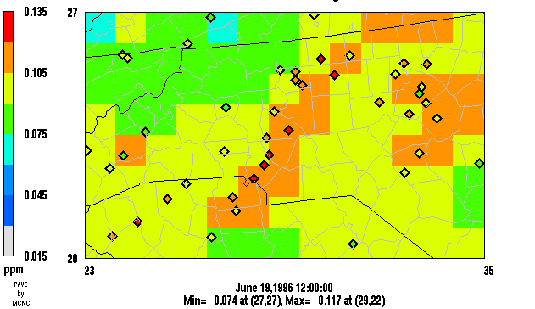
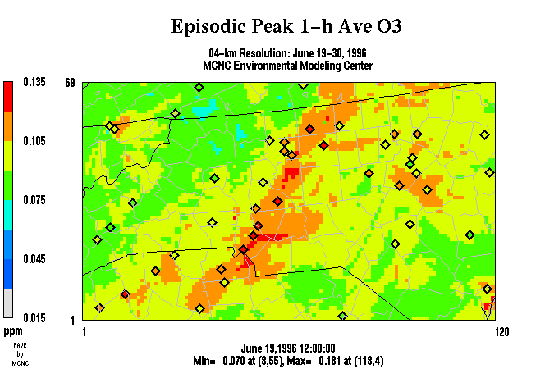
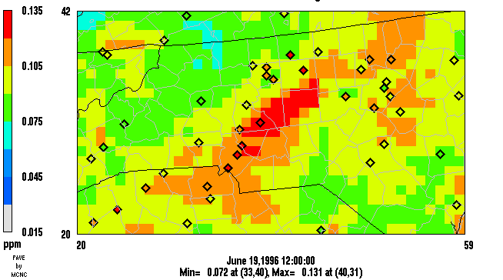
MPE Example 1
Grid Resolution Variability
36-km
4-km
12-km

Slide 80
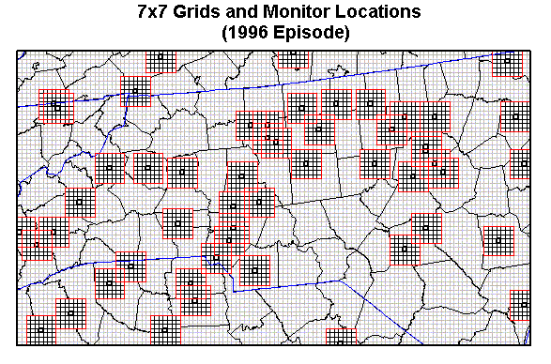
MPE Example 2
Spatial Variability of Peak Predictions

Slide 81
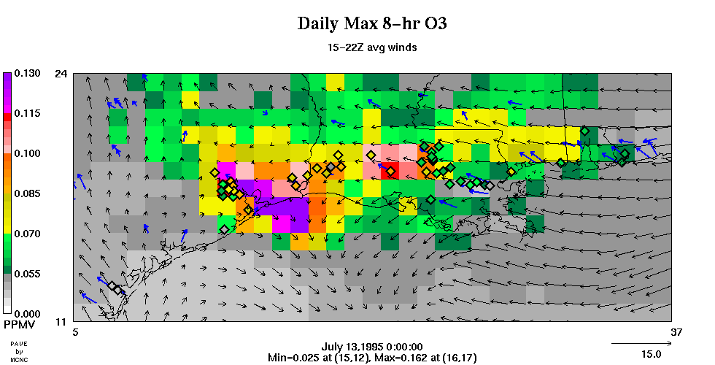
MPE Example 3
Wind and Obs Overlay

Slide 82
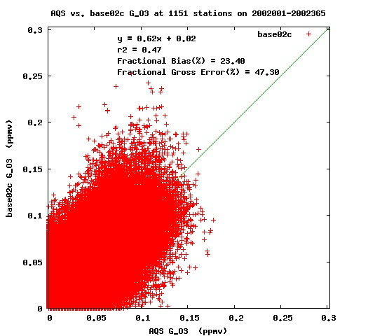
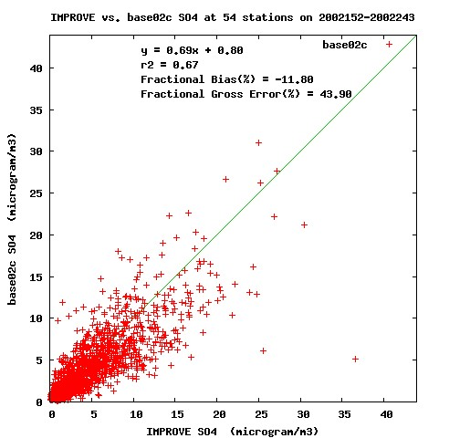
MPE Example 4
Scatter Plot Analyses
Regression analyses present model results across multiple observation points or time periods
O₃
SO₄

Slide 83
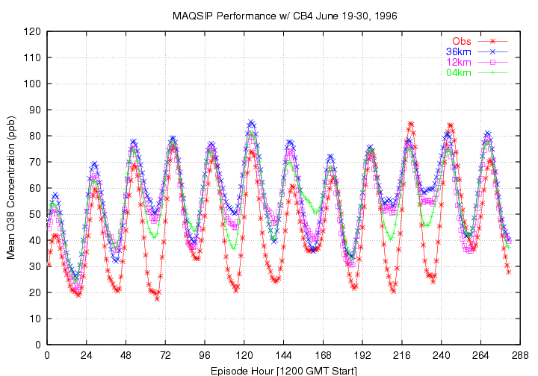
MPE Example 5
Time Series Analyses

Slide 84
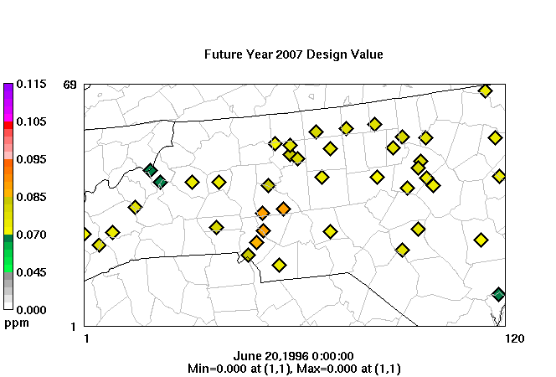
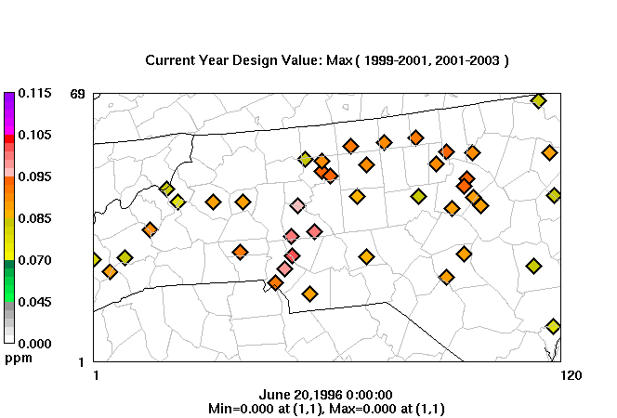


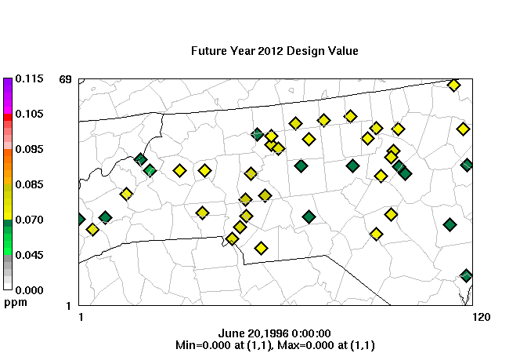
MPE Example 6
Attainment Demonstration for O₃

Slide 85
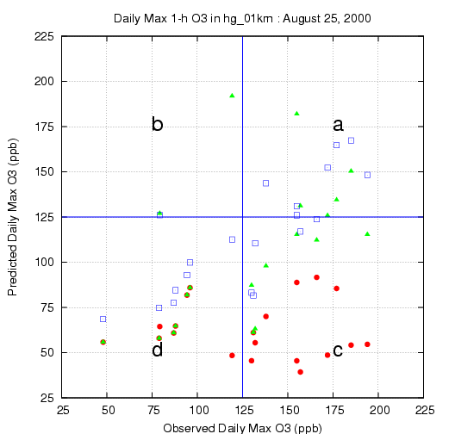
MPE Example 7
Forecast Model Evaluation

